Slide 1
Operating Systems
Chapter 3 (c)
Process Management
Hammad Afzal
hammad.afzal@mcs.edu.pk
Department of Computer Software Engineering
National University of Sciences and Technology

Slide 2
Roadmap
Inter-Process Communication
Examples of IPC Systems
Communication in Client-Server Systems

Slide 3
Inter-process Communication
Processes within a system may be independent or cooperating
Cooperating process can affect or be affected by other processes,
Any process sharing data with other.
Reasons for cooperating processes:
Information sharing:
e.g. a share file)
Computation speedup:
break process into sub tasks and each will execute in parallel with other (given multiple process units)
Modularity:
dividing the system into separate processes and threads

Slide 4
Inter-process Communication
Two models of IPC
Shared memory (SM):
A region of memory that is shared by cooperating processes is established.
Process then read and write data in shared region.
Message passing (MP)
Messages exchanged between two processes.
Many systems implement both mechanisms.
MP useful for exchange small data; easier to implement for inter-computer communication. Slower than SM as they are implemented using system calls (kernel intervention).
SM allows maximum speed; System calls required only to establish shared memory region.

Slide 5
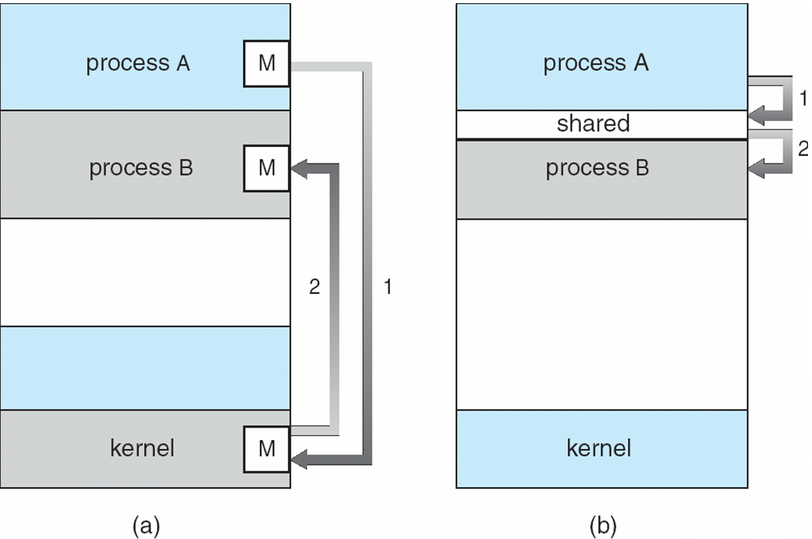
Communications Models

Slide 6
Shared Memory Systems
Shared Memory region resides in address space of creating process.
Other processes attach them to shared region.
OS restricts processes to read/write in other’s space.
Both process must agree to remove this restriction.
Form of data and location are decided by processes (not by OS).
Processes ensure that they access location simultaneously.

Slide 7
Producer-Consumer Problem
Paradigm for cooperating processes,
Producer process produces information that is consumed by a consumer process. E.g. compiler produces assembly code that is used by assembler.
Also provides useful metaphor for client-server.
Server is producer, client is consumer.
For Shared Memory implementation, we can have a buffer in shared memory space available that can be filled by producer and emptied by consumer.
Producer and consumer can produce and consume simultaneously.
They must synchronize.

Slide 8
Producer-Consumer Problem
Two types of Buffers.
unbounded-buffer places no practical limit on the size of the buffer.
bounded-buffer assumes that there is a fixed buffer size
The code for accessing and sharing the memory region should be written by application programmer.

Slide 9
Bounded-Buffer – Shared-Memory Solution
Shared data
#define BUFFER_SIZE 10
typedef struct {
. . .
} item;
item buffer[BUFFER_SIZE];
int in = 0;
int out = 0;
Solution is correct, but can only use BUFFER_SIZE-1 elements

Slide 10
Message Passing
Slides onward are mostly about the concepts that you have studied (or will be studying) in Computer Networks

Slide 11
Message Passing
Mechanism for processes to communicate and to synchronize their actions
Message system – processes communicate with each other without resorting to shared variables (address space).
Particularly useful in distributed systems where processes reside on different systems.
E.g. Chat programs running on different systems.
IPC facility provides two operations:
send(message) – message size fixed or variable
receive(message)

Slide 12
Message Passing
Messages Size
Fixed or Variable
If P and Q wish to communicate, they need to:
establish a communication link between them
exchange messages via send/receive
Implementation of communication link
physical (e.g.,hardware bus, network)
logical (e.g., logical properties)

Slide 13
Implementation Questions
How are links established?
Can a link be associated with more than two processes?
How many links can there be between every pair of communicating processes?
What is the capacity of a link?
Is the size of a message that the link can accommodate fixed or variable?
Is a link unidirectional or bi-directional?

Slide 14
Direct Communication
Processes must name each other (sender and receiver) explicitly:
send (P, message) – send a message to process P
receive(Q, message) – receive a message from process Q
Properties of communication link
Links are established automatically between every pair of communicating processes; they should know the names only.
A link is associated with exactly one pair of communicating processes
Between each pair there exists exactly one link
The link may be unidirectional, but is usually bi-directional
Symmetry: Both senders and receivers need names
Asymmetry: Sender names recipient, receiver doesn’t know the sender.

Slide 15
Indirect Communication
Messages are directed and received from mailboxes (also referred to as ports)
Mailbox: an object into which messages can be placed by processes and from which messages can be removed.
Each mailbox has a unique id.
Processes can communicate only if they share a mailbox
Properties of communication link
Link established only if processes share a common mailbox
A link may be associated with more than two processes
Each pair of processes may share several communication links
Link may be unidirectional or bi-directional

Slide 16
Indirect Communication
Primitives are defined as:
send(A, message) – send a message to mailbox A
receive(A, message) – receive a message from mailbox A
Mail Box owner
Mailbox owned by Process
Mailbox is in same address space; we distinguish between owner (only receive) and user (only send to)
Mailbox owned by OS: A process may
Create a new mailbox
Send and receive messages through mailbox
Destroy a mailbox

Slide 17
Indirect Communication
Mailbox sharing
P₁, P₂, and P₃ share mailbox A
P₁, sends; P₂ and P₃ receive
Who gets the message?
Solutions
Allow a link to be associated with at most two processes
Allow only one process at a time to execute a receive operation
Allow the system to select arbitrarily the receiver. Sender is notified who the receiver was.
The system may define an algorithm (round robin for example, each process takes turn). System may identify the receiver to the sender.

Slide 18
Some Code Snippets Not included in Theory Exam

Slide 19
Bounded-Buffer – Producer
while (true)
{ /* Produce an item */
while (((in = (in + 1) % BUFFER SIZE count) == out)
; /* do nothing -- no free buffers */
buffer[in] = item;
in = (in + 1) % BUFFER SIZE;
}

Slide 20
Bounded Buffer – Consumer
while (true) {
while (in == out)
; // do nothing -- nothing to consume
// remove an item from the buffer
item = buffer[out];
out = (out + 1) % BUFFER SIZE;
return item;
}

Slide 21
Examples of IPC Systems - POSIX
POSIX Shared Memory
Process first creates shared memory segment
Process wanting access to that shared memory must attach to it
Now the process could write to the shared memory
When done a process can detach the shared memory from its address space
Finally to remove from system, the system call shmctl() is used.
segment id = shmget(IPC PRIVATE, size, S IRUSR | S IWUSR);
shared memory = (char *) shmat(id, NULL, 0);
sprintf(shared memory, "Writing to shared memory");
shmdt(shared memory);

